Slide 1




Finance And Risk
Analytics
Audio explanation here
Prashasti Pandey
Date: 16/08/21

Slide 2
Index
The analysis is divided into 5 parts:
Data Understanding – Demographic and Credit bureau information
Identifying important variables using Exploratory Data Analysis •
Predictive modelling
• Modelling on demographic data only • Modelling on combined data of demographic and credit bureau variables.
Application scorecard
• Identifying the optimal score for rejecting the applicant
Financial Benefits
• Assessing the potential benefits of using predictive models for auto-approval
Audio explanation here

Slide 3
Steps Involved In Project
Import all the important libraries
Import all the 25 data files for each stocks
Only keep the ‘Date’ and ‘Close’ columns in all the stocks
Merge all the 24 stocks data in a single dataframe
For active investment strategy only keep the last 5 years data
Visualizations of stocks
Build the ARIMA model to forecast the stocks
Portfolio Management
Audio explanation here

Slide 4
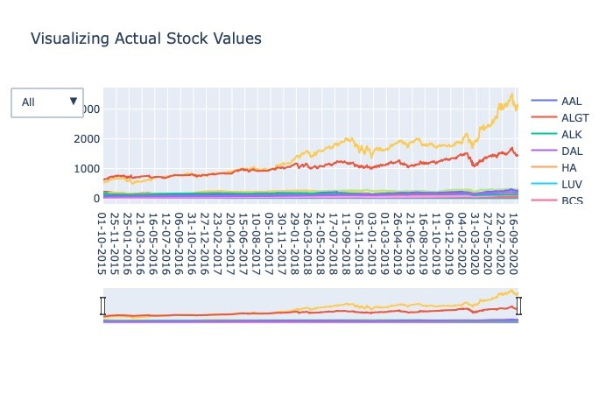
Actual Stocks Values
Audio explanation here

Slide 5
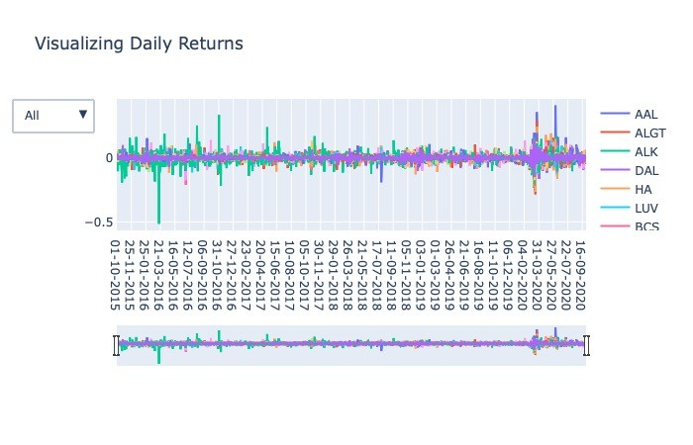
Daily Stocks Returns

Slide 6
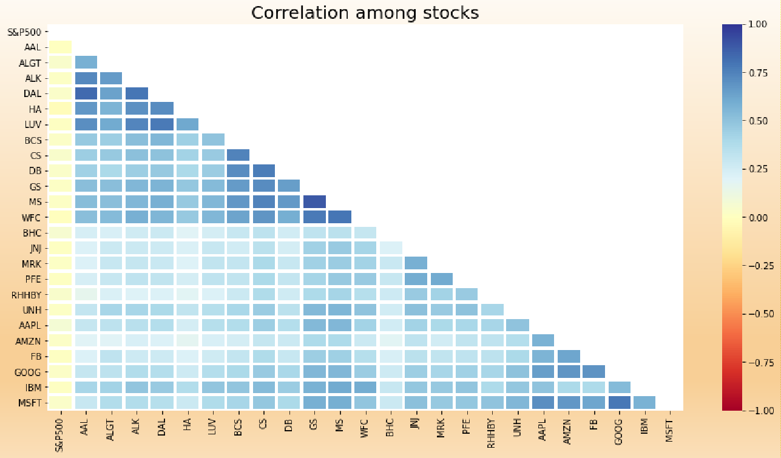
Stocks Heatmap

Slide 7
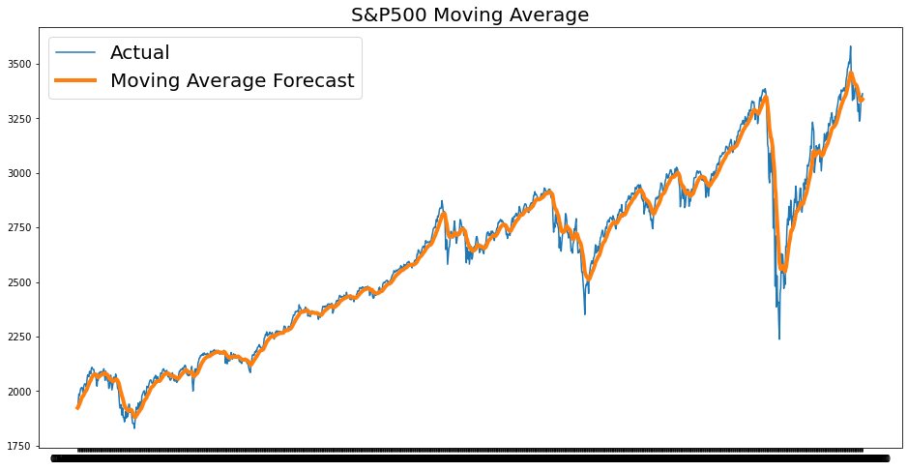
Moving Average Forecast

Slide 8
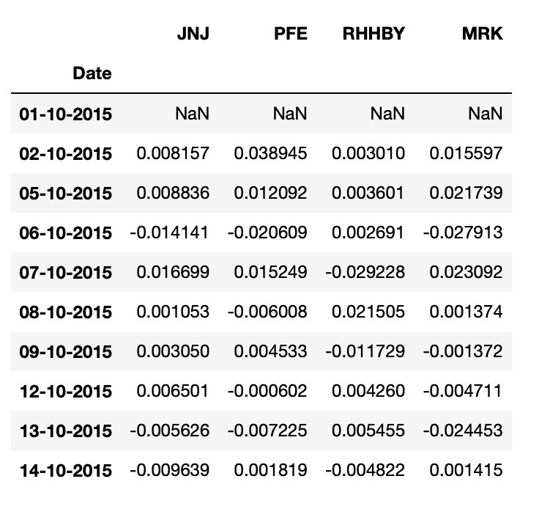
Mr. Patrick Jyenger
Suggested Stocks for Mr. Patrick Jyenger
Mr. Patrick Jyenger
Wants to maintain a decent standard of living post his retirement
Has always been a conservative investor during his life
Available capital of 1 million dollars; Wants to invest 500k dollars in a magazine (Naturo) for minority stake and remaining 500k dollars in equities
Expects doubling his capital with less risk in 5 years' time to buy a minority portion of Naturo

Slide 9
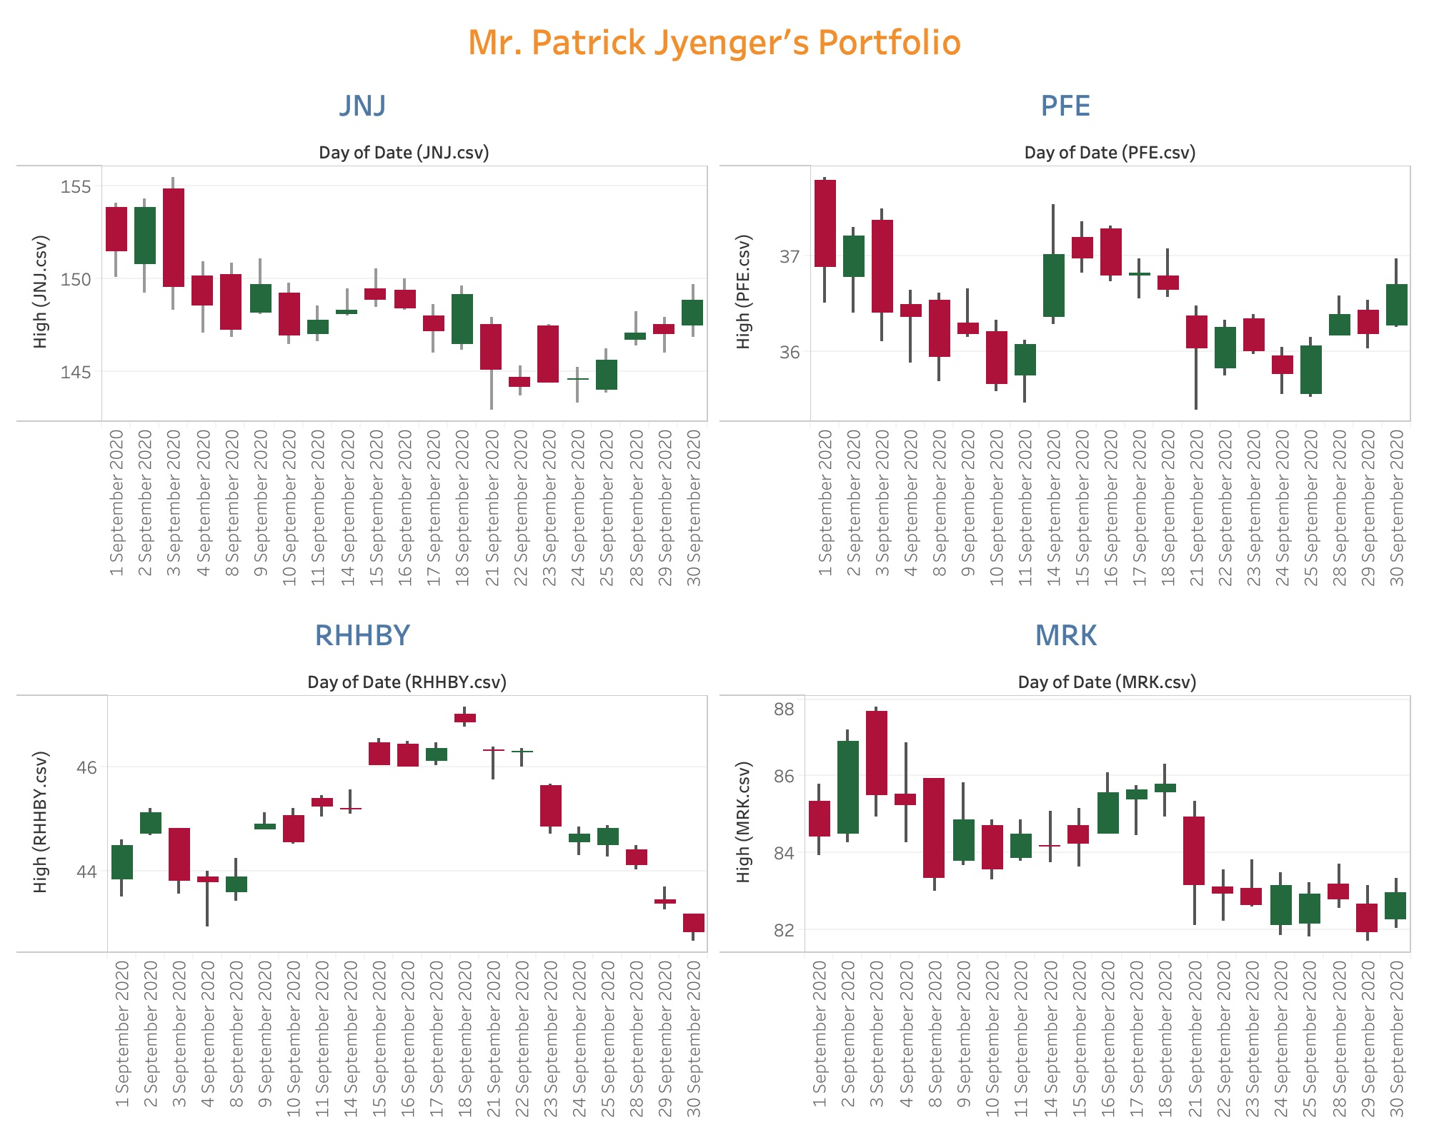
Mr. Patrick Jyenger’s Portfolio

Slide 10
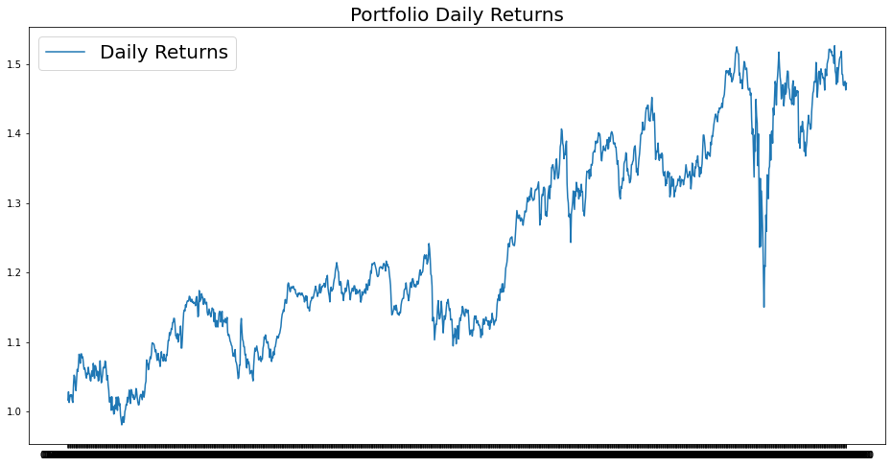
Mr. Patrick Jyenger’s Returns
Portfolio cumulative returns is around 118% on the last day, which is almost double in the given time.
The risk of Mr. Patrick Jyenger’s portfolio is 34.7 %.

Slide 11
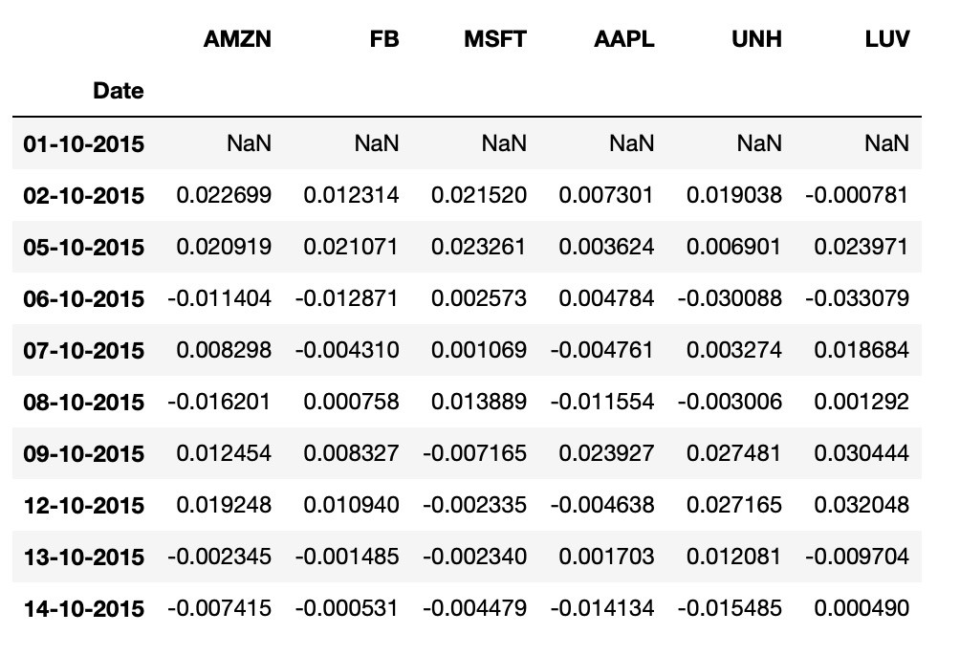
Mr. Peter Jyenger
Suggested Stocks for Mr. Peter Jyenger
Mr. Peter Jyenger
Consistent with his attitude towards risk, he prefers high return investments
Believes that he can still bounce back in case of any occasional losses
Wants to invest 1 million dollars from company's cash and cash equivalents in the most high-margin stocks
Expects high returns within 5 years for inorganic expansion of JWW

Slide 12
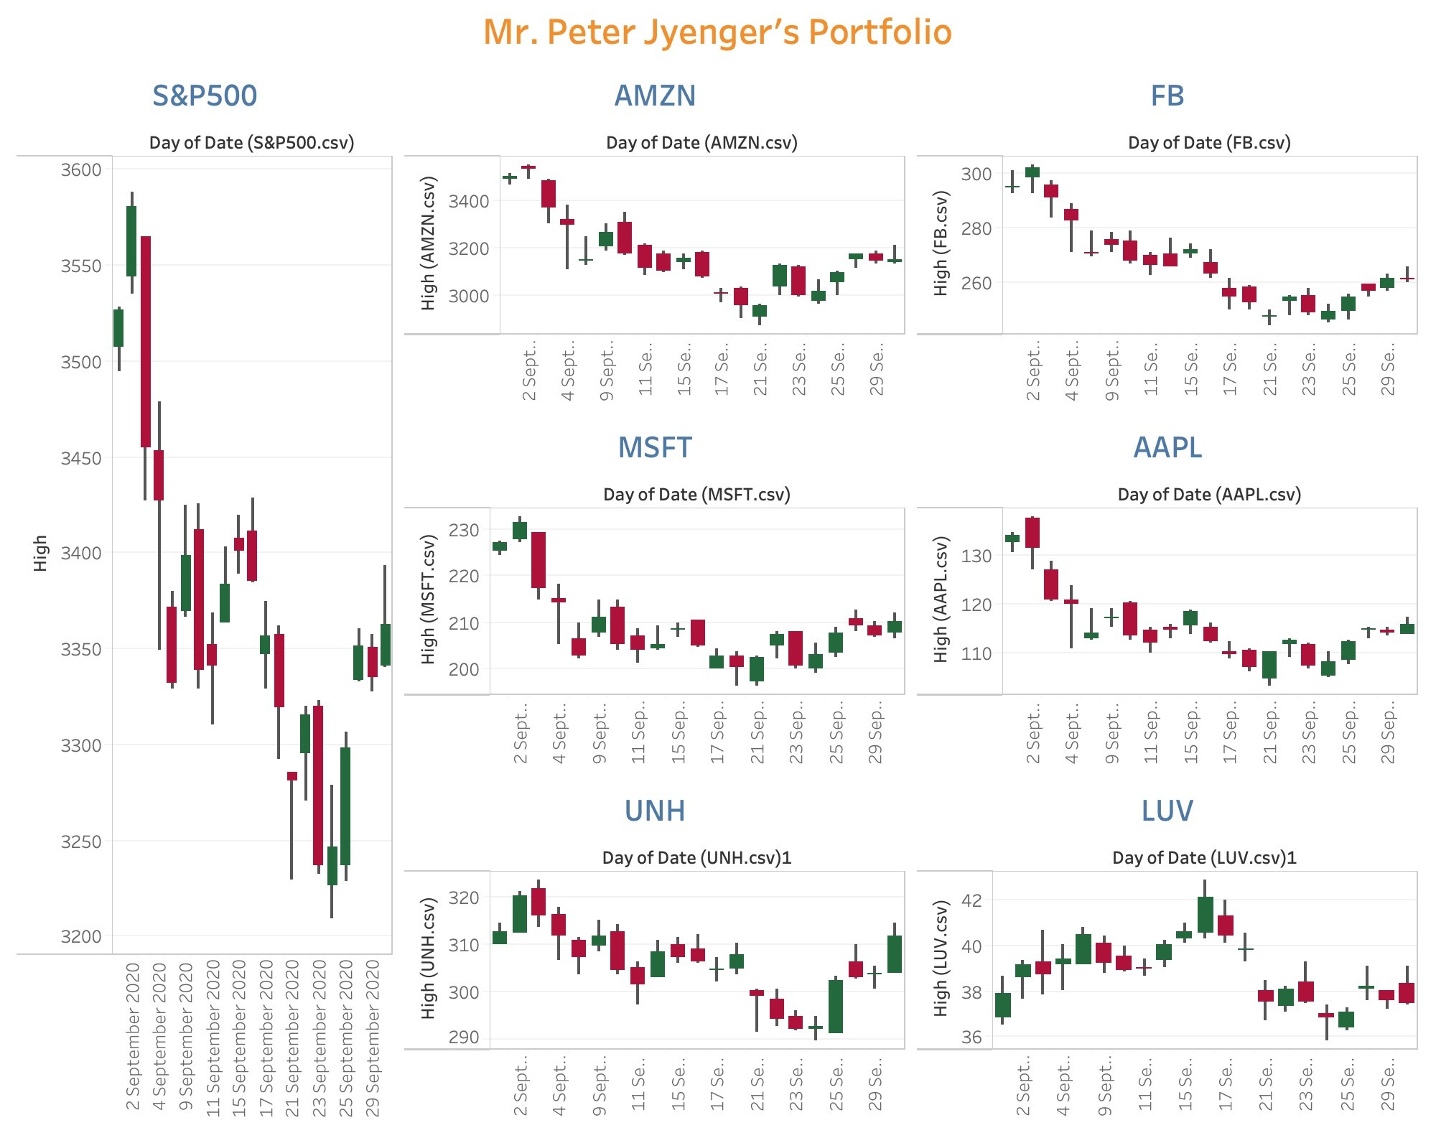
Mr. Peter Jyenger’s Portfolio

Slide 13
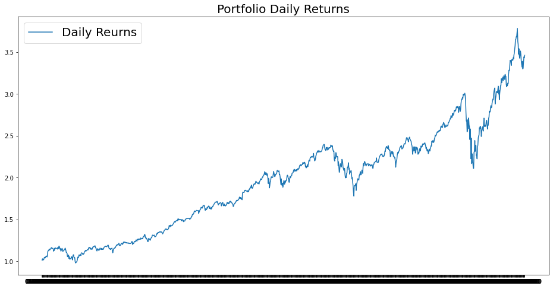
Mr. Peter Jyenger’s Returns
Portfolio cumulative returns is around 756% on the last day for these stocks together which is very high.
The risk of Mr. Peter Jyenger’s portfolio is 46.7%.

Slide 14
Thank You

